Slide 1
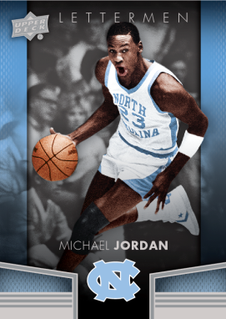
2014-15 UD Lettermen
Basketball
Configuration:
4 cards per pack
10packs per box
12 boxes per case
Set Breakdown:
Veterans – 50 cards
Premier Rookies – 30 cards (#’d to 999)
Product Highlights:
Monumental Logo Patches
Championship Banners
Home Court Stars
Rookie Premier Lettermen
Arrival Date: November 2014

Slide 2
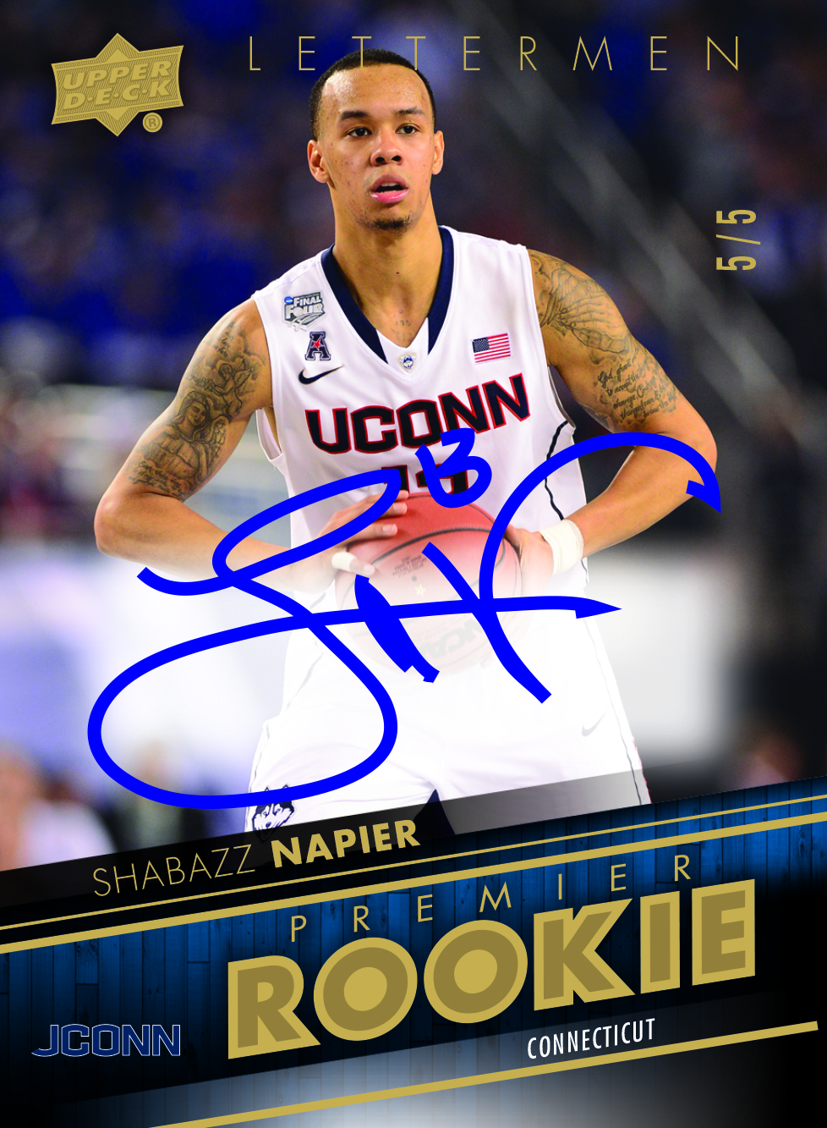
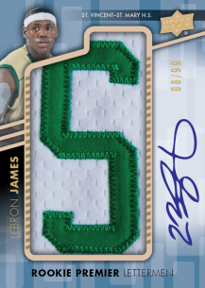
2014-15 UD Lettermen
Basketball
Box Break Summary:
Two (2) Autographs per box!
Includes one (1) Lettermen Auto from rookies and legends like:
Michael Jordan, LeBron James, Larry Bird, Paul George, Aaron Gordon, Elfried Payton, Nik Stauskas, Doug McDermott, Dariio Saric, Shabazz Napier, and more!
1-2 Memorabilia cards per box! From unique inserts like:
Monumental Logo Patches (#’d to 50 or less)
Championship Banners (#’d to 125 or less)
Retired Numbers (#’d to 99 or less)
Home Court Stars (1:15)
Six (6) base card parallels #’d to 499 or less per box!
Includes Blue, Silver and Gold parallels!

Slide 3
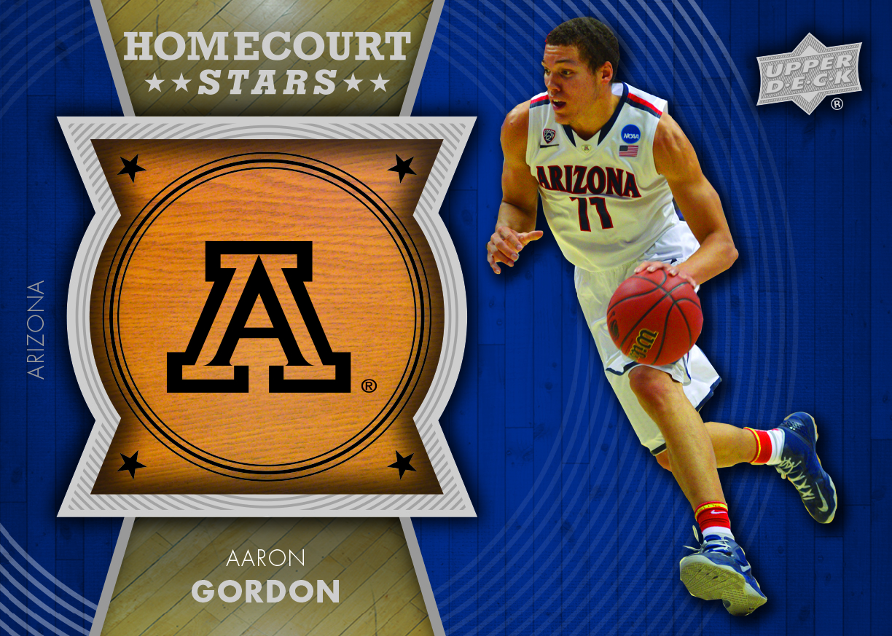
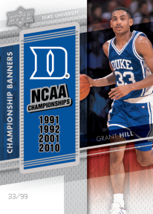
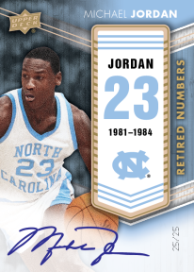
2014-15 UD Lettermen
Basketball
Collect cool inserts like Home Court Stars!
Look for Autographed parallels and logo variations!
Championship Banner Patch cards commemorating past national title winners!
Retired Numbers
Including rare autograph parallels!

