Slide 1
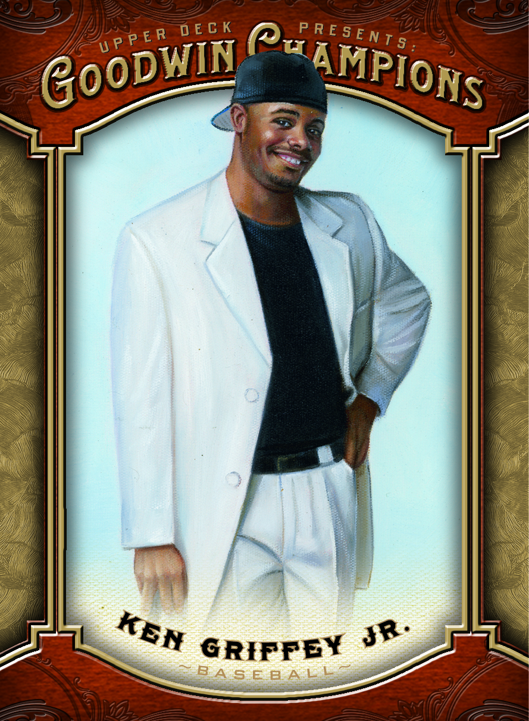
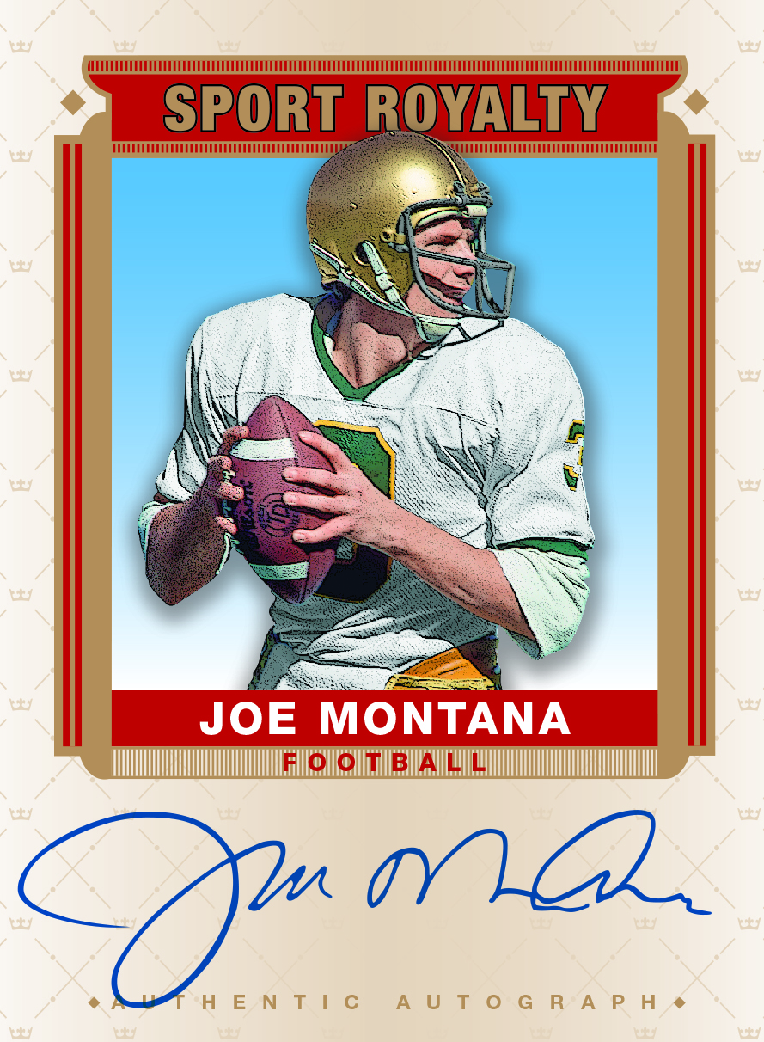
2014 Goodwin Champions
Configuration:
5 cards per pack
20 packs per box
16 boxes per case
Product Highlights:
NEW! Monsters 3D cards!
NEW! Origin of Species Patch Cards!
NEW! World War I Museum Relics!
Goodwin Masterpieces – Art of the Ages set continues!
Arrival Date: July 2014
New signers for Goodwin Champions:
Joe Montana, Peyton Manning, Lindsey Vonn, Canelo Alvarez, Jerry Tarkanian, Ken Griffey Jr, LaDainian Tomlinson, Eric Dickerson, Bill Russell, Byron Buxton, Graeme McDowell, and more!!
Look for autos from Winter Olympians:
Shani Davis (USA - Speed Skating), Ashley Caldwell (USA – Freestyle Skiing), Steven Holcomb (USA - Bobsled), Hayley Wickenheiser (Canada - Hockey), Julie Chu (USA - Hockey)

Slide 2
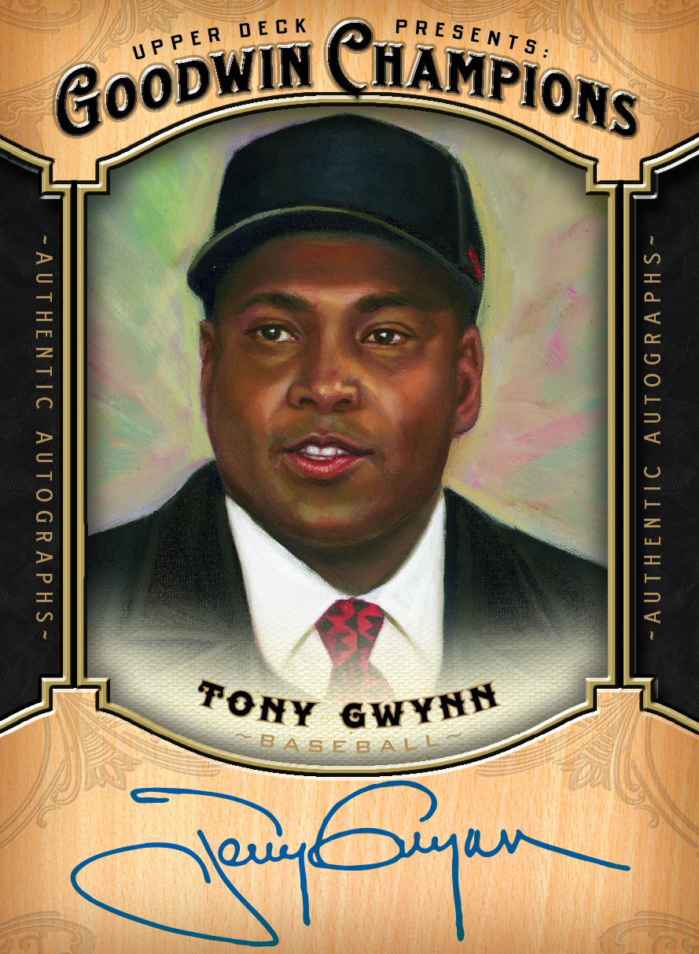
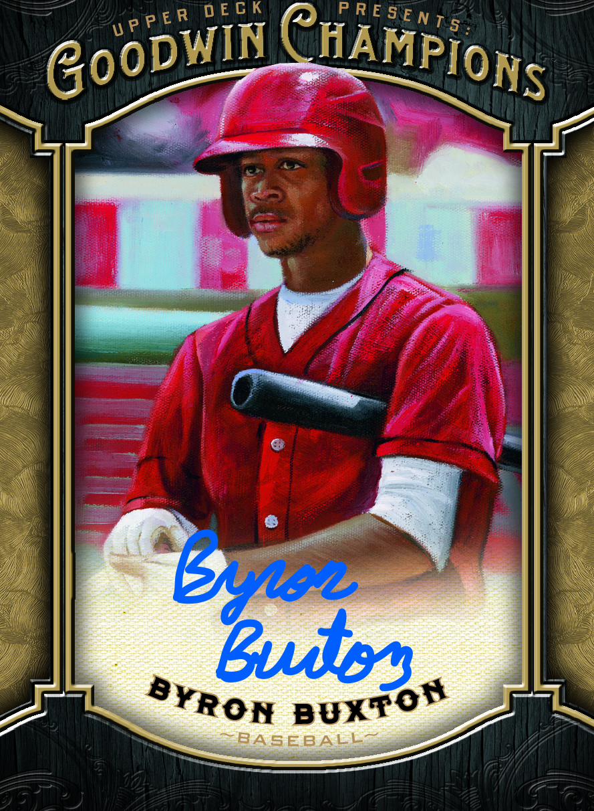
2014 Goodwin Champions
Box Break Summary:
Three (3) per box from:
Hard signed autographs
Single or dual swatch mem cards
Origin of Species patch cards
Goodwin Masterpieces – Art of the Ages
Museum Relics
Ten (10) Goodwin Champions minis
Look for rare Magician Back and Presidential Back parallels
Every pack has either a Mini, short-print, or insert!
Case Break Summary:
Five (5) Origin of Species Patch cards
Four (4) Monsters 3-D cards
One (1) Dual-swatch memorabilia short-print
One (1) Sport Royalty memorabilia card

Slide 3
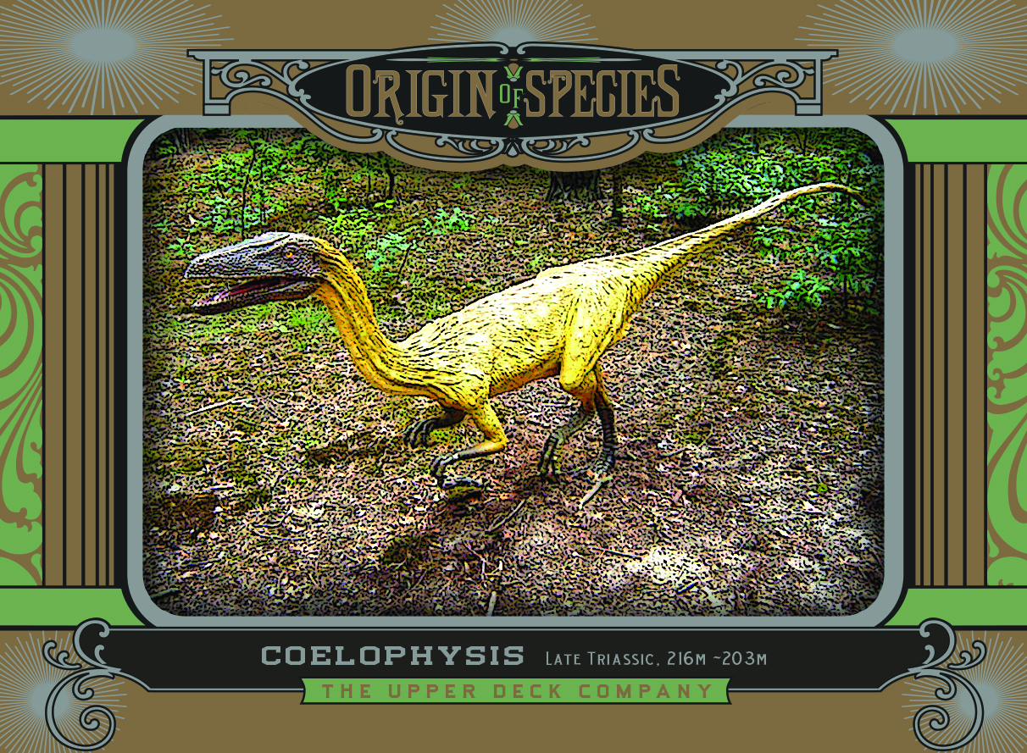
2014 Goodwin Champions
Introducing ALL NEW Origin of Species Patch Cards!
The beginning of a 3-year program
2014: The Dawn of Complex Life in 2014!
Tier 1 – Reptiles
Tier 2 – Fish
Tier 3 – Cambrian Explosion
Tier 4 – Arthropods
Tier 5 – Tetrapods
Tier 6 - Cephalopods
Falling five (5) per case!
Cards checklisted OS-1 thru OS-100 with varying levels of rarity!!

Slide 4
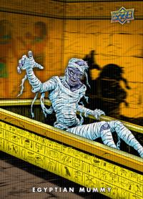
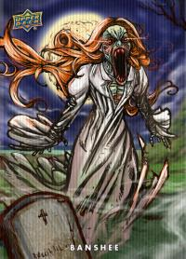
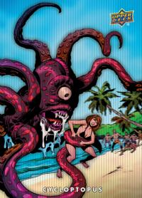
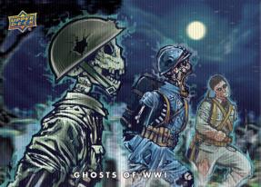
2014 Goodwin Champions
Start your collection of 3-D MONSTERS! Collect:
Bizarre Beasts (1:120)
Classic Creatures (1:360)
The Giants (1:870)
Alien Menaces (1:4,160)

Slide 5
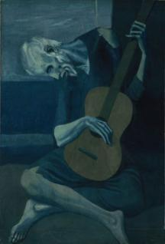
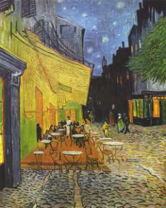
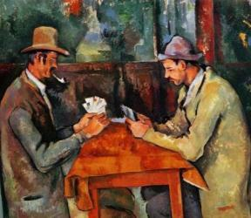
2014 Goodwin Champions
Continue your collection of beautifully hand-painted Goodwin Masterpieces Art of the Ages cards!
ALL New 300 paintings from masterpieces like:
Vincent Van Gogh – Café Terrace at Night
Pablo Picasso – Old Guitarist
Paul Cezanne – The Card Players (most expensive painting ever sold!)
And more!

