Slide 1
2014 SP Authentic Football
Configuration:
5 cards per pack
20packs per box
12 boxes per case
Set Breakdown:
Regular Cards – 100
Rookie Short Prints – 30 (1:7)
Legends Short Prints – 20 (1:10)
Authentic Moments – 50 (1:4)
Rookie Auto Patches – 35 (#’d to 550 or less)
Product Highlights:
SP Rookie Auto Patch (#’d to 550 or less)
SPA Future Watch Autographs (#’d to 5 or less)
Authentic Moments Autographs (1:87)
Canvas Collection Short Prints (1:45)
Arrival Date: November 2014

Slide 2
2014 SP Authentic Football
Box Break Summary:
Three (3) Autographs per box!
Including one (1) Rookie Auto Patch #’d to 550 or less!
Look for rare inscribed parallels #’d to 10 or less!
Four (4) Canvas Collection inserts per box!
Includes rare autographed versions and short prints!
Three (3) SPA Future Watch inserts #’d to 999 per box!
Collect rare red parallels #’d to 99 and autographed parallels #’d to 25 or less!

Slide 3
2014 SP Authentic Football
Get three (3) Super FX bonus packs per case!
Each Super FX bonus pack contains one (1) Super FX Autograph card PLUS two (2) Super FX Rookie or Legend cards!

Slide 4
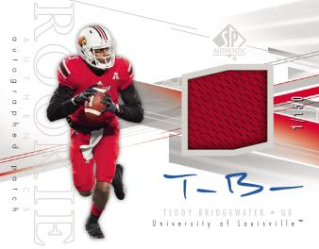
2014 SP Authentic Football
Look for autographs from rookies and legends like:
Johnny Manziel
Blake Bortles
Sammy Watkins
Teddy Bridgewater
Carlos Hyde
and many more!
Peyton Manning
John Elway
Matthew Stafford
Jerry Rice
Dan Marino
Ben Roethlisberger

Slide 5
2014 SP Authentic Football
Collect the entire 235-card set including the 50 Authentic Moments cards highlighting some of the biggest moments in college football history!
Including rare autograph parallels!

Slide 6
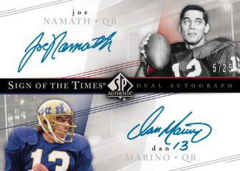
2014 SP Authentic Football

