Slide 1
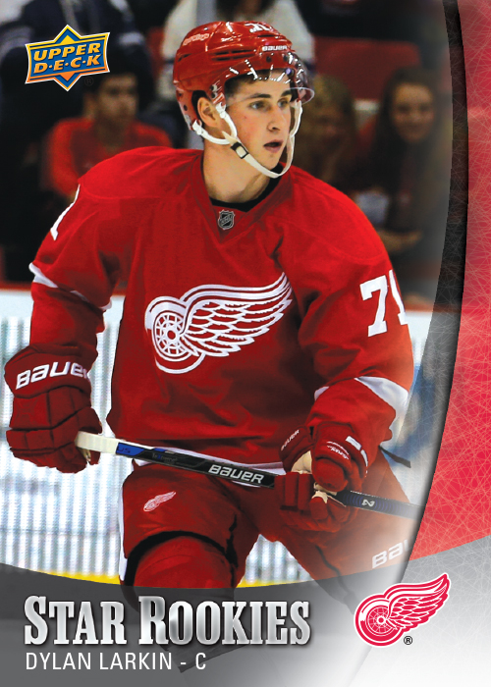
2015-16
NHL STAR ROOKIES
BOX SET
PRODUCT HIGHLIGHTS
A Collection Of This Year’s Top Rookies!
Every Box Will Contain 25 Different Skaters!
Look For Autograph Parallels Of The Base Set!
- Approximate odds one per case -
Dylan Larkin
Connor McDavid
Artemi Panarin

Slide 2
NHL STAR ROOKIES
BASE SET
CONFIGURATION
25 Cards Per Box
20 Boxes Per Case

Slide 3
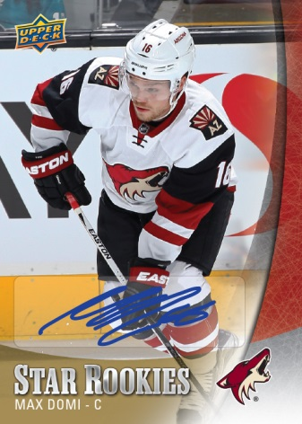
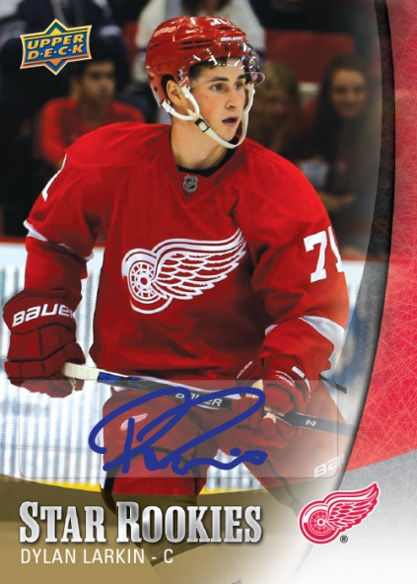
NHL STAR ROOKIES
BASE SET AUTO PARALLEL
Chance to Collect a Top Rookie Autograph!

